Slide 1

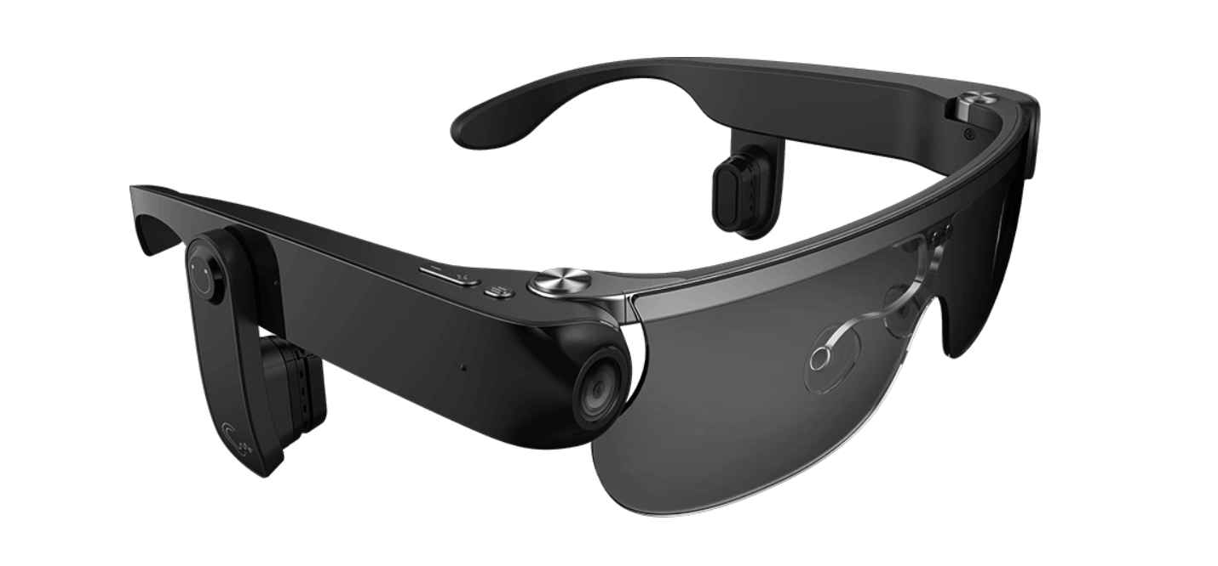
visual-assist glasses
Team members
Lihan Zhao
Tianlei Shi
Xingbo Wei
Hening Fan
Zhichao Ma

Slide 2
Pre Outline
To tell you with the related topics about the project we choose
To introduce several potential issues our group members have found about this technique
To talk about the solutions which might be helpful to solve the mentioned problems

Slide 3

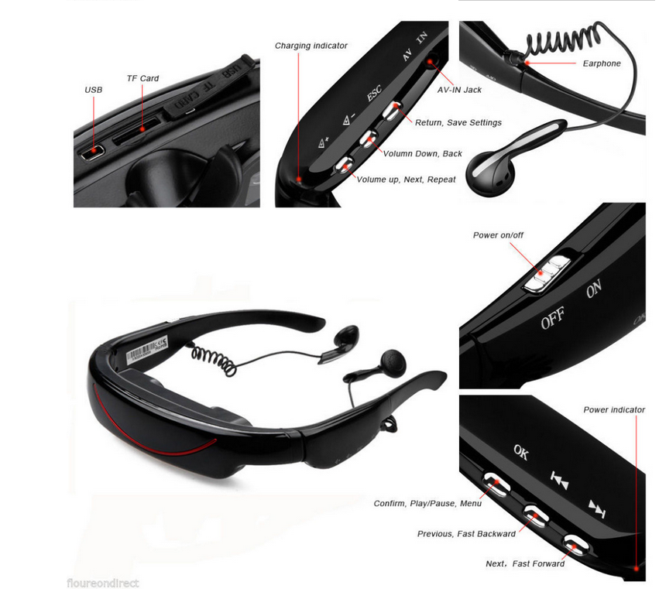
Tangible device
Tangible device
Where the idea came from
Providing visual assistance for the blind people.
Navigation function
Mainly depends on voice interaction
Not only took the main development ideas of the existing products, but also made revolutionary innovations[1].

Slide 4
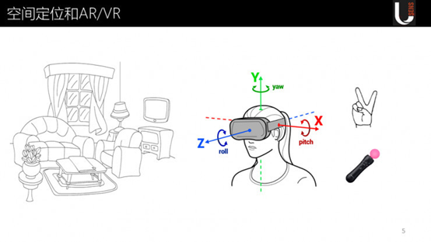


How this device interacts with humans
Human:
voice interaction
touch interaction
head gesture interaction
Device:
A series of recognition functions

Slide 5

Some potential issues
In three different SITUATIONs
During the process of voice interaction
Happens at the stage of head gesture interaction.
Portability and convenience[2].

Slide 6

The possible solutions of the mentioned problems
Apply knowledge graph and knowledge embedding
Adding light-sensitive facilities together with the gyroscopes used for comparing the head positions.
Using ear conduction instead of earphones[3].

Slide 7

Conclusion
Come up with a new human computer interaction: a pair of glasses to perform assisting tasks for people with visual barriers (tangible device).
3 possible problems together with their solutions
Thank you!

Slide 8
References：
[1] ‘eSight - Electronic eyewear for the visually impaired’. https://esighteyewear.com/ (accessed Mar. 18, 2021).
[2] ‘Glasses Assist the Blind | listings at Tech-enhanced Life’. https://www.techenhancedlife.com/resources/glasses-assist-blind (accessed Mar. 18, 2021).
[3] ‘Watch: Smart glasses provide a visual assist | Engineering360’. https://insights.globalspec.com/article/14720/watch-smart-glasses-provide-a-visual-assist (accessed Mar. 18, 2021).

